Slide 1
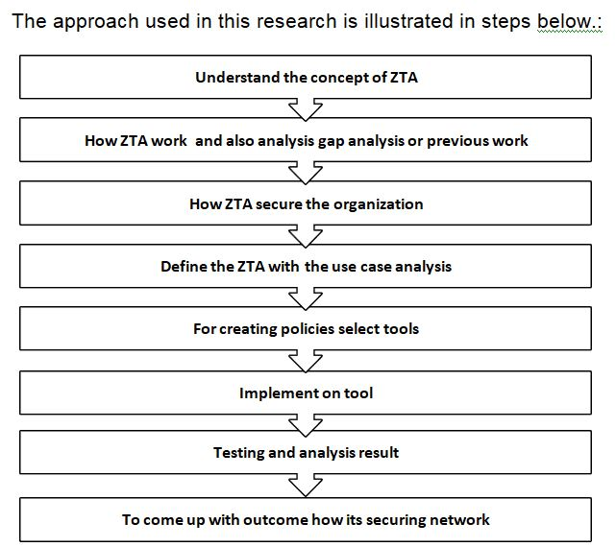
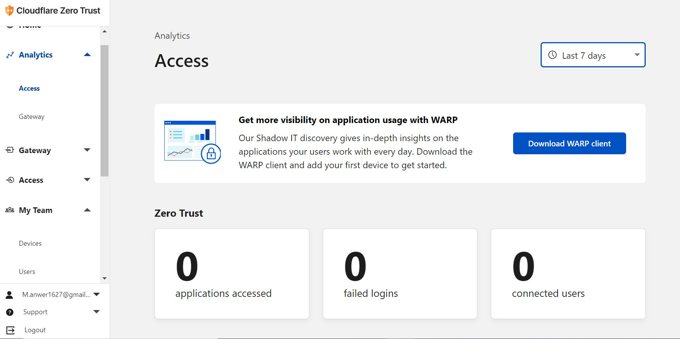
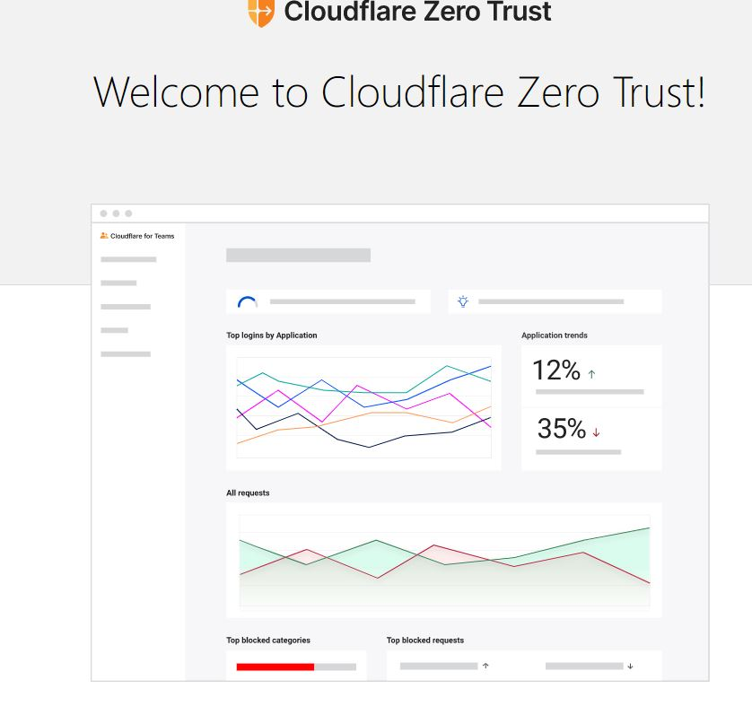

ZTA
Your name, student ID
MSc Project, Supervisor: name
ABSTRACT
ZTA is a new approach to cybersecurity that benefits firms who have sensitive data & outsource staff who do not operate from office computers. It safeguards various resources such as information, internet backbone identities, and other services. The word derives from the system's essential idea of verifying each access to the source. The verification operation is performed regularly based on traffic workload regardless of computer or human position. Using the same machine while "conserving" the potential of information availability is impossible. In this research, we use Cloudflare to deploy an application and implement a zero trust model
RESEARCH METHODOLOGY
TESTING
Check Cloud flare ZT devices:
Check user in ZT:
Data Analytics
Log Analysis
DISCUSSION / CONCLUSIONS
ZTA is a novel technique for collecting & managing company data. Its key advantage is accessing it from any region and on every device. It limits the quantity of information & needs the standard procedure on a regular schedule, lowering the danger of computer security. The possibility of granting partial access to data is advantageous for data security and arranging the hierarchical system inside the company.
I cover the idea and use of ZTA in this research. Some obstacles with ZTA are mentioned & discussed, such as a lack of standardization & vendor lock-in issues. Finally, a summary of the methods and considerations for cloud-based Zero trust architecture on cloud flare was implemented
RESULTS / EVALUATION
INTRODUCTION
This research aim is to comprehend how the zero-trust network architecture method safeguards the user from any place & device & provides a security architecture.
CC, mobile device use, and the Internet of Things have all disrupted the old network limits. The organization is developing a mechanism to secure access privileges from any place & device. The open-source project will be used to investigate how the ZTA approach protects the company.
REFERENCES
Garbis, J. a. J. W. C., 2021. Zero Trust Security: An Enterprise Guide.. Berkeley, CA: Apress,.
Gilman, E. a. D. B., 2017. Zero trust networks.. O'Reilly Media, Incorporated,.
Greenwood, D., 2021. Applying the principles of zero-trust architecture to protect sensitive and critical data.. Network Security 2021, no. 6.
Kerman, A., 2020. Implementing a zero trust artitecture. NIST.
Kerman, A. O. B. S. R. a. A. T., 2020. Implementing a zero trust architecture.. National Institute of Standards and Technology (NIST) .
DESIGN / DEVELOPMENT
Use Cloud flare dashboard for implement ZTA
SCHOOL OF COMPUTER SCIENCE AND TECHNOLOGY

